Slide 1
MOVING AVERAGE
UTKARSHA GUPTA
MT19DCS002

Slide 2
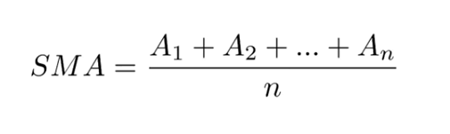
A moving average (MA) is a widely used indicator in technical analysis that helps smooth out price from random short-term price fluctuations. It is a trend-following, or lagging, indicator because it is based on past prices.

Slide 3
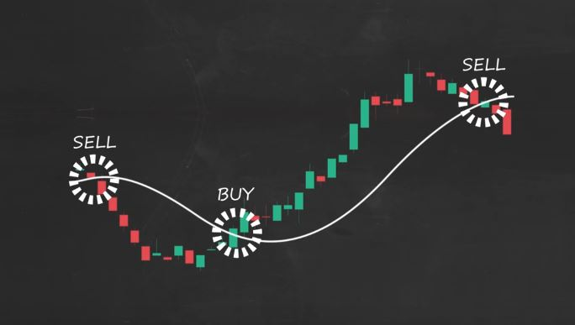

Slide 4
Data set:
Reliance Global Group, Inc.
Time period- 1st january 2019-1st january 2020

Slide 5
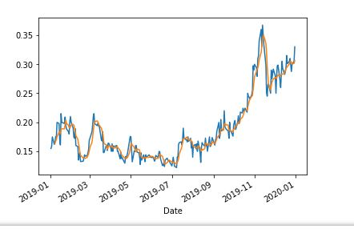
For window size=5

Slide 6
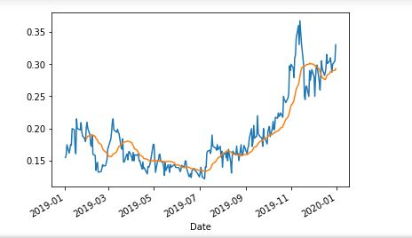
For window size=20

Slide 7
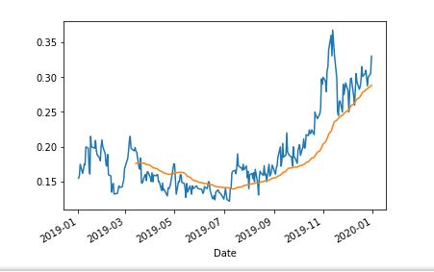
For window size =50

Slide 8
